Slide 1
Immune Deconvolution Benchmark
Scope and preliminary results
2018-05-25

Slide 2
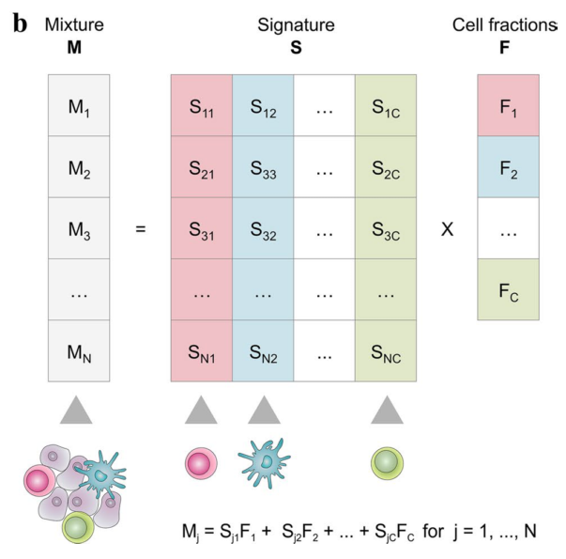
What is immune deconvolution?
Input: “bulk” RNAseq gene expression data
Output: estimated cell fractions for the sample
Why?
For many samples (including TCGA), cell fractions are not measured independently, but highly relevant for e.g. indication priorisation.
Finotello, F., & Trajanoski, Z. (2018). Quantifying tumor-infiltrating immune cells from transcriptomics data. Cancer Immunology, Immunotherapy, 0. https://doi.org/10.1007/s00262-018-2150-z

Slide 3
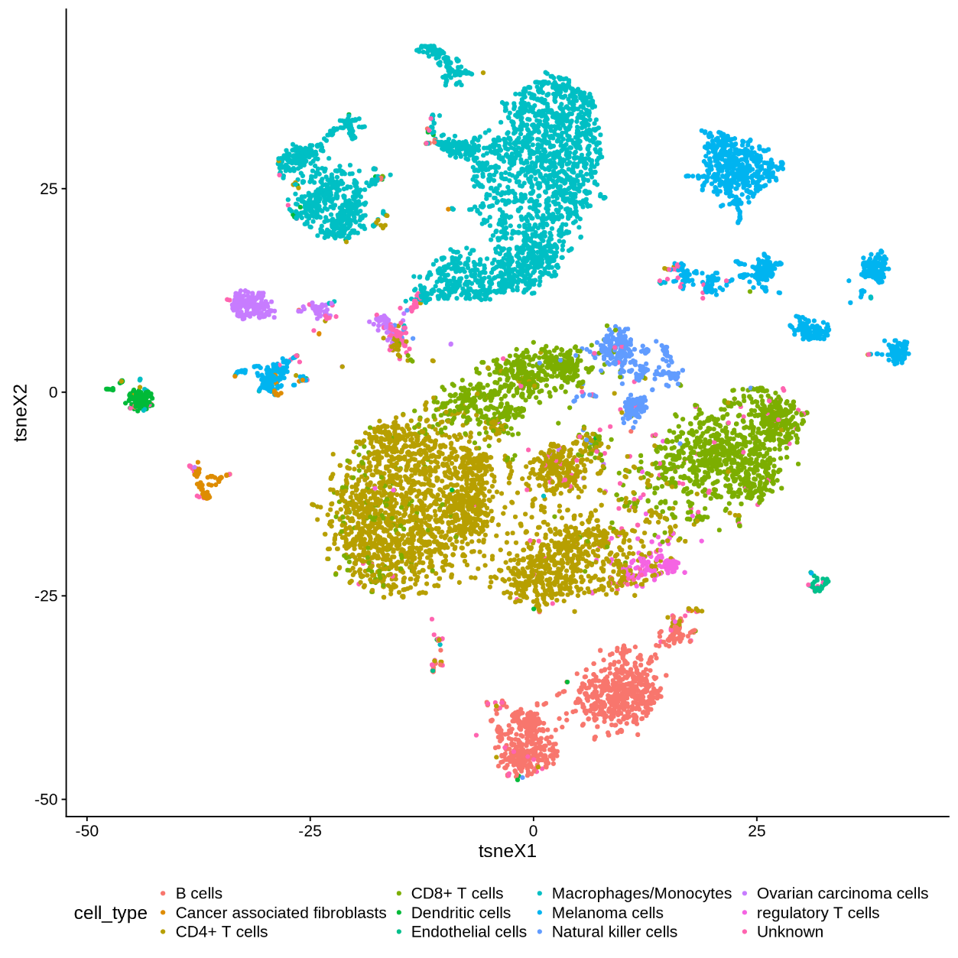
Single cell input data
Single cell RNAseq data from ~12k single cells of different types
Public dataset
Schelker, M., Feau, S., Du, J., Ranu, N., Klipp, E., MacBeath, G., … Raue, A. (2017). Estimation of immune cell content in tumour tissue using single-cell RNA-seq data. Nature Communications, 8(1), 2032. https://doi.org/10.1038/s41467-017-02289-3

Slide 4
Validation datasets
Bulk RNAseq with matched cell type proportions
IHC/Flow cytometry
Public data
87 samples in total, though couldn’t get access to all of them (yet)
Study | # Samples | Sample Type | Gene Expression by | Validation by | Cell types
Finotello 2017 | 9 | CRC | RNAseq | IHC | CD3, CD8, CD45RO, FOXP3, PD1
Finotello 2017 | 9 | PBMC/PMN | RNAseq | FlowCytometry | B, Mono, Neu, NK, CD4, CD8, Treg, DC
Hoeck 2015 | 8 | PBMC/PMN | RNAseq | FlowCytometry | T, B, NK, MDC, Mono, Neu
Johnson 2015 | 31 | metastatic melanoma | RNAseq | IHC | CD8, CD4, FOXP3+
Racle 2017 | 4 | metastatic melanoma | RNAseq | FlowCytometry | B, CD4, CD8, NK, Melanoma/other
Zimmermann 2016 | 12 | PBMC before influenza vacc | RNAseq | FlowCytometry | B, CD4, CD8, NK, Mono, Other
Schelker 2017 | 3 | ovarian cancer ascites | RNAseq | FlowCytometry + Single Cell RNAseq | CD8, CD4, B, NK, DC, Mono, ...
Chung 2017 | 11 | BRCA | RNAseq | Single Cell RNAseq + IHC for B and T

Slide 5
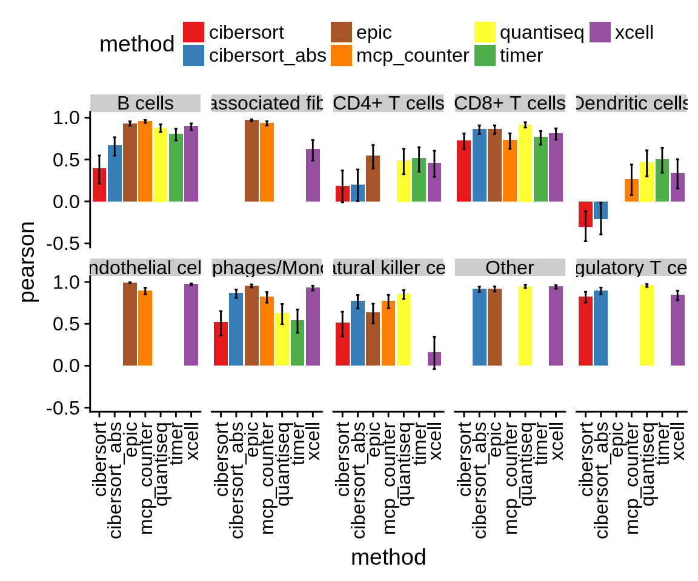
Results: single cell mixing
Methodology:
Generate random, simulated “bulk sample” from 500 single cells
Run deconvolution methods
Correlate true cell fractions with known cell fractions
Results (see figure):
Pearson correlation for each cell type and method
Observations
Deconvolution works well for some cell types with all methods (e.g. CD8+ T cells, B cells)
All methods struggle to deconvolute DC and CD4+ T cells

Slide 6
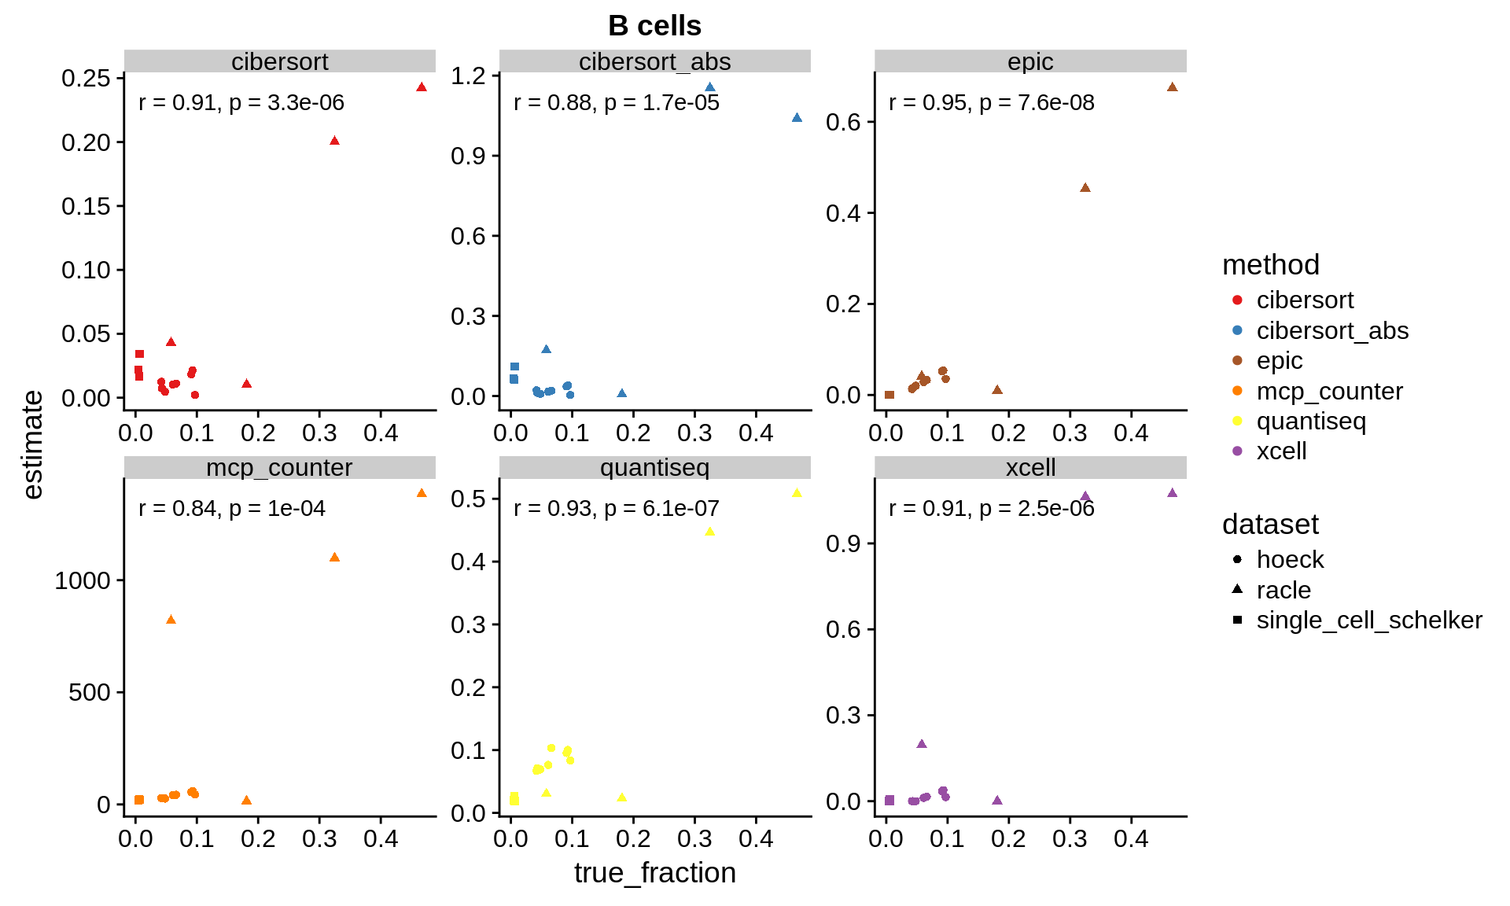
Results: validation datasets
Work still in progress
Example for B cells and 3 datasets:

Slide 7
More details…
An always up-to-date, step-by-step report of what I’ve done is available on eldorado:
http://eldorado/projects/immune_deconvolution_benchmark/_book/

